Slide 1
Day 3 – Model Drive Apps

Slide 2
Content
Introduction To Model drive apps
Data Modeling
Types of Data Modeling
Data Modeling Process
Data Modeling Techniques
Introduction to Dataverse
Why to choose Dataverse
Terminology updates (Legacy vs Current)
Environments
Environment Types
Practical demonstration of Environment handling
Q&A

Slide 3
Introduction
Model-driven app design is an approach that focuses on adding components such as forms, views, and charts and dashboards to tables using an app designer tool.
Additionally, relationships connect tables together in a way that permits navigation between them and ensures that data is not repeated unnecessarily.
Using the app designer with little or no code, you can build apps that are simple or very complex
Model driven apps are responsive by default
UI customization is limited and restricted
Follows Data focused/Data oriented approach (Data Modeling)

Slide 4
Data Modeling
Data modeling is the process of creating a visual representation of either a whole information system or parts of it to communicate connections between data points and structures.
The goal is to illustrate the types of data used and stored within the system, the relationships among these data types.
There are manily 3 types of data modeling
Conceptual Data Modeling
Logical Data Modeling
Physical Data Modeling

Slide 5
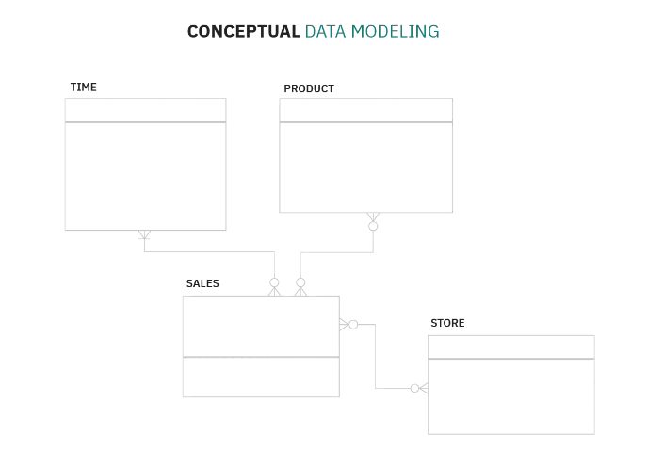
Conceptual Data Modeling
They are also referred to as domain models and offer a big-picture view of what the system will contain, how it will be organized, and which business rules are involved
Conceptual models are usually created as part of the process of gathering initial project requirements

Slide 6
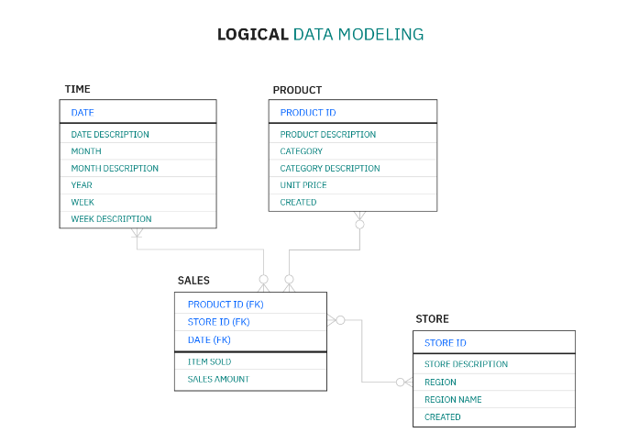
Logical Data Modeling
They are less abstract and provide greater detail about the concepts and relationships in the domain under consideration
These indicate data attributes, such as data types and their corresponding lengths, and show the relationships among entities
Logical data models don’t specify any technical system requirements

Slide 7
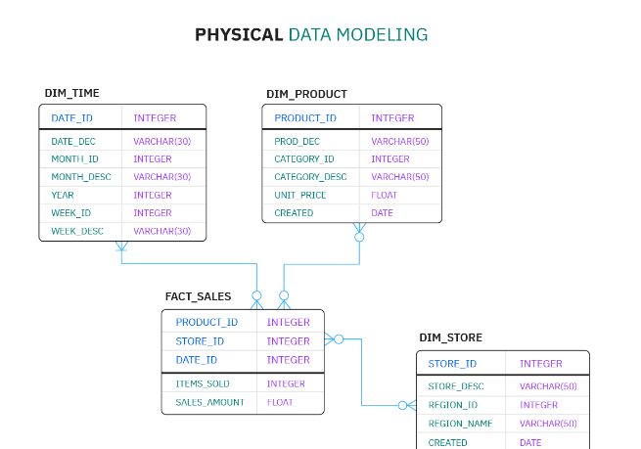
Physical Data Modeling
These are more detailed and offer finalized designed structure
Illustrate entity relationship, Primary/Foreign keys
Physical data modeling can include database management system (DBMS)-specific properties, including performance tuning

Slide 8
Data Modeling Process
Identify the entities
Identify key properties of each entity
Identify and Setup relationships among entities
Map attributes/fields to entities completely
Assign keys as needed, and decide on a degree of normalization that balances the need to reduce redundancy with performance requirements
Finalize and validate the data model

Slide 9
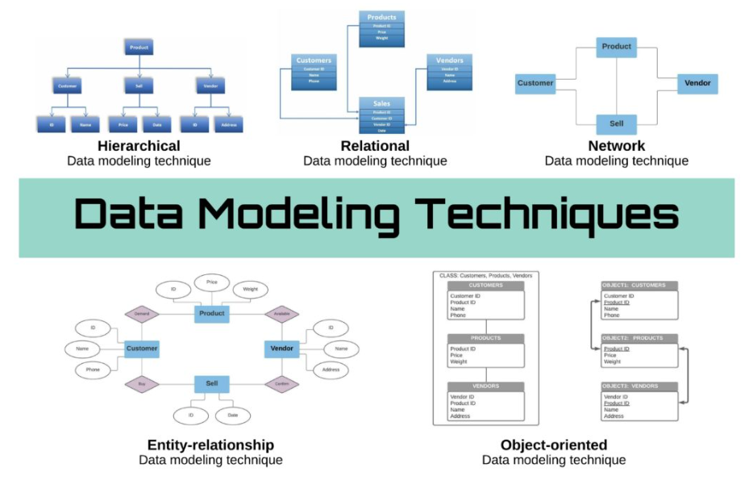

Slide 10
Dataverse
Dataverse lets you securely store and manage data that's used by business applications.
Data within Dataverse is stored within a set of tables.
A table is a set of rows (formerly referred to as records) and columns (formerly referred to as fields/attributes)
Dataverse includes a base set of standard tables that cover typical scenarios, but you can also create custom tables specific to your organization and populate them with data by using Power Query
Common Data Service (CDS) — the data storage system that intensifies Dynamics 365 and Power Platform — has changed its name to Dataverse, part of a bigger rebrand at Microsoft. Dataverse does the same thing as CDS — but with a different name

Slide 11
Why to use Dataverse
Standard and custom tables within Dataverse provide a secure and cloud-based storage option for your data.
Tables let you create a business-focused definition of your organization's data for use within apps.
Easy to manage – Both the metadata and data are stored in the cloud. You don't need to worry about the details of how they're stored.
Easy to secure – Data is securely stored so that users can see it only if you grant them access.
Role-based security (RBAC) allows you to control access to tables for different users within your organization.

Slide 12
Why to use Dataverse (Continued)
Access your Dynamics 365 Data – Data from your Dynamics 365 applications is also stored within Dataverse, allowing you to quickly build apps that use your Dynamics 365 data and extend your apps with Power Apps.
Rich metadata – Data types and relationships are used directly within Power Apps.
Logic and validation – Define calculated columns, business rules, workflows, and business process flows to ensure data quality and drive business processes.
Productivity tools – Tables are available within the add-ins for Microsoft Excel to increase productivity and ensure data accessibility.

Slide 13
Terminology Updates (Legacy vs Current)
Responding to customer feedback and data from user research, effective November 2020 Microsoft has updated some terminology in Dataverse and make its usage more productive.
These terminology updates aren’t applicable to any APIs or messages in the Dataverse web services.
For example, the names of messages the CreateEntityRequest and CreateAttributeRequest won't change.
Legacy(Dynamic 365) Terms | Current (Dataverse) Terms
Entity, entities | Table, tables
Field, fields Attribute, attributes | Column, columns
Record, records | Row, rows
Option set, multi select option sets Picklist, picklists | Choice, choices
Two Options | Yes/No

Slide 14
Environments in Power Platform
A Power Platform environment is a space to store, manage, and share your organization's business data, apps, chatbots, and flows.
It also serves as a container to separate apps that might have different roles, security requirements, or target audiences. How you choose to use environments depends on your organization and the apps you're trying to build.
For example:
You can choose to only build your apps or chatbots in a single environment.
You might create separate environments that group the test and production versions of your apps or chatbots.
You might create separate environments that correspond to specific teams or departments in your company, each containing the relevant data and apps for each audience.
You might also create separate environments for different global branches of your company.

Slide 15
Some Facts about Environment
Environments are containers that administrators use to manage asset in your organization
Each environment is created under an Azure Active Directory (Azure AD) tenant
Power Apps automatically create a single Default environment for each tenant
Environments enable you to separate applications.
Each environment resource can only be accessible by the user within its tenant
Each Environment can have zero to one CDS database.
Environment is also bound to geographic location
You can delete the environment, except you can delete the Default one
You can recover a recently deleted environments (Within 7 days of deletion)

Slide 16
Types of Environments
Below are the types of environments in Power Apps
Default
Developer
Microsoft Dataverse for Teams
Trial
Sandbox
Production

Slide 17
Default Environment
A single default environment is automatically created by Power Apps for each tenant and shared by all users in that tenant.
Whenever a new user signs up for Power Apps, they're automatically added to the Maker role of the default environment
The default environment is created in the region closest to the default region of the Azure AD tenant.
You can’t delete or backup the default environment
Storage capacity is limited to 1TB, for more storage you should create production environment
It has 3 GB Dataverse Database Capacity, 3 GB Dataverse File Capacity, and 1 GB Dataverse Log Capacity
The default environment is named as follows: "{Azure AD tenant name} (default)“
E.g. AZA Technology Services(Default)

Slide 18
Developer Environment
Developer environments are created by users who have the Developer/Community Plan license
They're special environments intended only for use by the owner
Provisioning developer environments can be restricted to admins
The developer environment will be available as long as you actively use the Power Apps Developer Plan
Cannot be shared
For Individual use
Applications can be moved out of the environment if needed

Slide 19
Microsoft Dataverse for Teams Environment
Dataverse for Team environments are automatically created for the selected team when you create an app in Teams using the Power Apps app for the first time or install a Power Apps app from the app catalog
Limited control. Admins have limited settings available for Teams environments.
No customizations of security role or assignments are available
Team members are automatically mapped to their Teams membership type - Owners, Members, and Guests - with a corresponding security role assigned by the system.

Slide 20
Trial Environment
This type of environment expires after 30 days.
Trial environments are intended to support short-term testing needs.
Trial environments are automatically cleaned after the expiration period that is 30.
If you want to use the environment for more than 30 days, you must convert the trial to a Production environment.
User has full security control in trial environment
It is limited to one user only.

Slide 21
Trial Environment (continued)
In Trial environment, there are two types that you can use:
Standard trial environment
Trial (subscription-based)
Standard Trial Environment
The company uses this type of trial environment to enable users to try new features, and quickly build applications in Power apps.
Any user from that organization who has a suitable license can create a 30 days trial environment.
The creation of the trial environment can be restricted to admins only.
Trial (subscription-based)
Companies can use this type of trial environment to develop larger, multi-user, and multiple-department solutions.
No Days Limit
The Tenant admins can add a trial (subscription-based) environment to their tenant.
Max 25 Licenses

Slide 22
Sandbox Environment
These are non-production environments, which offer features like copy and reset
Sandbox environments are used for development and testing, separate from production
User has full security control
Requires 1GB of Dataverse database capacity to provision.
Provisioning Sandbox environments can be restricted to admins
For Testing just User access is needed and for Development at least Environment Maker access is needed to create resources

Slide 23
Production Environment
This is intended to be used for permanent work in an organization
It can be created and owned by an administrator or anyone with a Power Apps license, provided there is 1 GB available database capacity
Production environments are what you should use for any environments on which you depend.
You can only create two production environments and two trial environments with your Power Apps P2 license.
Full Control

Slide 24
Thank You

